Slide 1
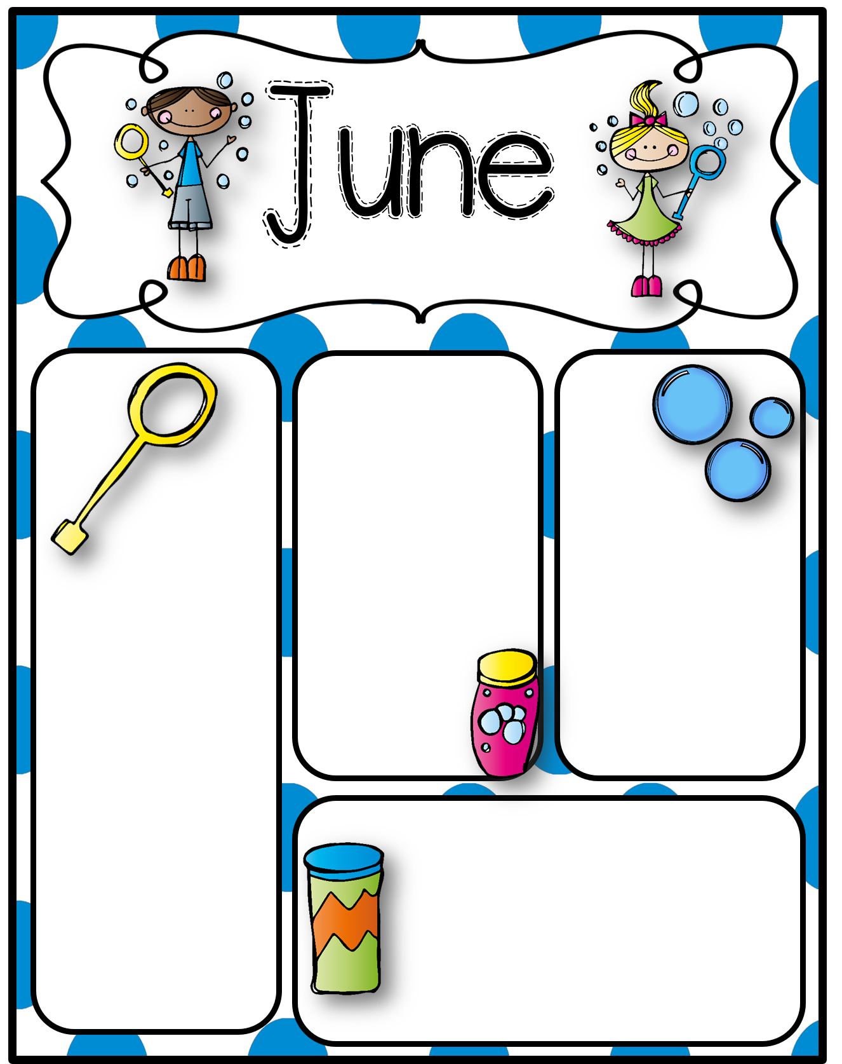
2021 NEWSLETTER
Upper Miramichi Elementary School
June 16 – 6:00 PM
Grade 5 Celebration
June 17 – 12:30 PM
Kindergarten Celebration
Celebrations will be Students, Staff and 2 Family members only due to Covid regulations.
Our year end celebration will include visiting the Rural community park and Woodsmen Museum.
JUNE 25
LAST DAY OF
SCHOOL FOR
STUDENTS
UMES
Students
participated
in the following
virtual
presentations:
- NB Museum Under The Seas
- UNB Worlds Unbound
They also participated in:
- Community Library
Hackmatack
- District Coding
Grade 4 provincial assessments were completed
UMES Reading
Challenge Bike
Winners Are:
- Macey Legere
- Cohen Palmer
Mathletics Program High Scores:
Gr. 5 – Bentley Munn
Gr. 4 – Levi Hovey
Gr. 3 – Cameron Fairley
Gr. 2 – Ava Cameron
Gr. 1 – Bentley Collins
Blue Jays Play Ball Program for Grades 4 & 5. Tuesday & Thursday after school for 5 weeks.
REMINDER:
The Breakfast and Milk Program will continue for June, but there will be no Hot Lunch!
FREE Pizza June 10
June 9 & 10
We will be celebrating Students Days!
With all the changes and challenges due to Covid we want to recognize the students for all their efforts, adaptions and respect this past school year.
The Community Library will be hosting a Literacy for Kids program and the Summer Reading Club!
Call 365-2096 to register

